Slide 1

8th Grade Math: Pre-Algebra
Unit 6, Lesson 6 Solving Real-World Problems Using Similar Triangles Volume 1, pg. 267

Slide 2


Benchmark
MA.8.GR.2.4
Solve mathematical and real-world problems involving proportional relationships between similar triangles.
volume 1, pg. 267

Slide 3
Integrated Mathematical Thinking and Reasoning Standards
MA.K12.MTR.1.1 Actively participate in effortful learning both individually and collectively.
MA.K12.MTR.2.1 Demonstrate understanding by representing problems in multiple ways.
MA.K12.MTR.4.1 Engage in discussions that reflect on the mathematical thinking of self and others.
MA.K12.MTR.5.1 Use patterns and structure to help understand and connect mathematical concepts.
MA.K12.MTR.7.1 Apply mathematics to real-world contexts.
volume 1, pg. 267

Slide 4

Learning Target
I can solve real-world problems using similar triangles.
volume 1, pg. 267

Slide 5

Warm-Up
volume 1, pg. 268

Slide 6
6.6.1 Warm-Up: Brains Think About Math Visually
Explain a time in math class when you used a visual representation of a problem to help solve it.
How did that visual representation help you?
volume 1, pg. 268

Slide 7

Exploration
volume 1, pg. 268

Slide 8

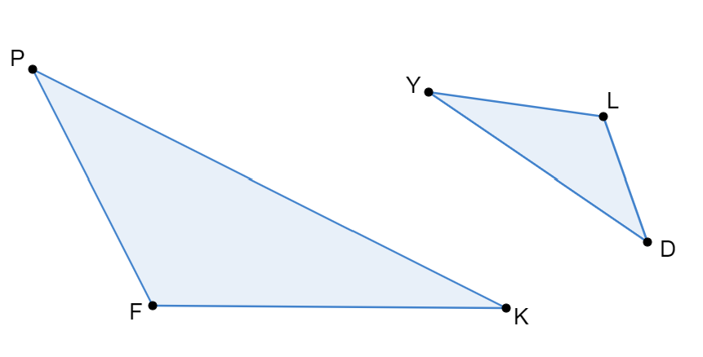
6.6.2 Exploration: Angles in Similar Triangles
The previous lesson introduced similar triangles and the relationship between their corresponding sides. The relative side lengths of the triangles in those situations were used to identify corresponding sides. In some cases, it may be more helpful to use angle measures to help identify corresponding sides.
Triangle 𝑃𝐹𝐾 and triangle 𝐷𝐿𝑌 are similar.
volume 1, pg. 268

Slide 9
Line segment 𝑃𝐾 corresponds to line segment 𝐷𝑌.
Line segment 𝑃𝐹 corresponds to line segment 𝐷𝐿.
Line segment 𝐹𝐾 corresponds to line segment 𝐿𝑌.
Mark the figures to show which sides correspond, based on the given information, using colors or symbols.
volume 1, pg. 268

Slide 10
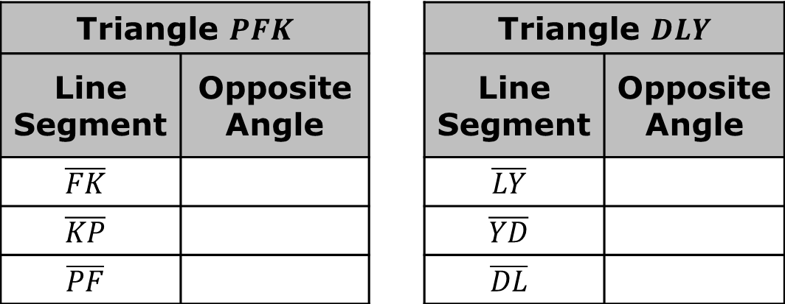
Identify the angles opposite each line segment.
Triangle $PFK$ |  |  | Triangle $DLY$
Line Segment | Opposite Angle |  | Line Segment | Opposite Angle
$$\overline{FK}$$ |  |  | $$\overline{LY}$$
$$\overline{KP}$$ |  |  | $$\overline{YD}$$
$$\overline{PF}$$ |  |  | $$\overline{DL}$$
volume 1, pg. 269

Slide 11
Angles opposite corresponding sides are called corresponding angles. Use colors or markings to show which angles correspond to each other on the triangles.
Complete the statement by identifying corresponding angle pairs in triangles 𝑃𝐹𝐾 and 𝐷𝐿𝑌.
∠𝑃𝐹𝐾 corresponds with ∠_________.
∠𝐹𝐾𝑃 corresponds with ∠_________.
∠𝐾𝑃𝐹 corresponds with ∠_________.
volume 1, pg. 269

Slide 12
Consider the size of each pair of corresponding angles. With your partner, write a hypothesis regarding the relationship between each angle pair.
Trace a copy of triangle 𝑃𝐹𝐾 on patty paper. Be sure to label each vertex.
volume 1, pg. 269

Slide 13
Place the copy of triangle 𝑃𝐹𝐾 on top of triangle 𝐷𝐿𝑌 so that angle 𝑃𝐹𝐾 overlaps angle 𝐷𝐿𝑌. What do you notice?
Repeat the process for each pair of corresponding angles.
volume 1, pg. 269

Slide 14

Discuss with your partner whether your observations support or disprove your hypothesis about the relationship between each angle pair. Then, summarize your discussion.
In similar triangles, corresponding angles have equal measures and are opposite corresponding sides.
volume 1, pg. 269

Slide 15

Guided Instruction
volume 1, pg. 270

Slide 16
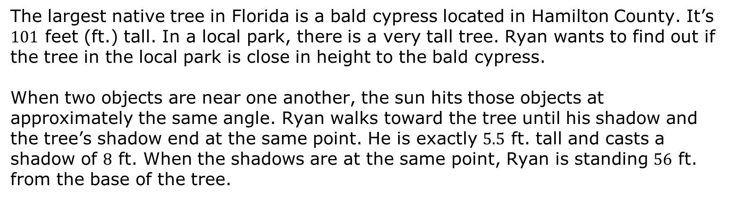
6.6.3 Guided Instruction: Using Similar Triangles to Solve Real-World Problems
The largest native tree in Florida is a bald cypress located in Hamilton County. It’s $101$ feet (ft.) tall. In a local park, there is a very tall tree. Ryan wants to find out if the tree in the local park is close in height to the bald cypress.
When two objects are near one another, the sun hits those objects at approximately the same angle. Ryan walks toward the tree until his shadow and the tree’s shadow end at the same point. He is exactly $5.5$ ft. tall and casts a shadow of $8$ ft. When the shadows are at the same point, Ryan is standing $56$ ft. from the base of the tree.
volume 1, pg. 270

Slide 17
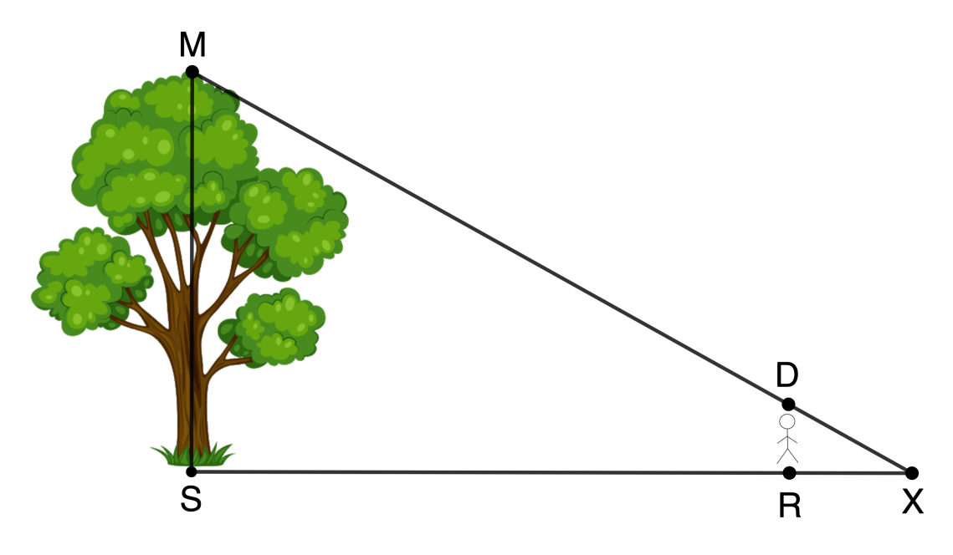
Label the diagram with the given information.
How long is the tree’s shadow?
volume 1, pg. 270

Slide 18
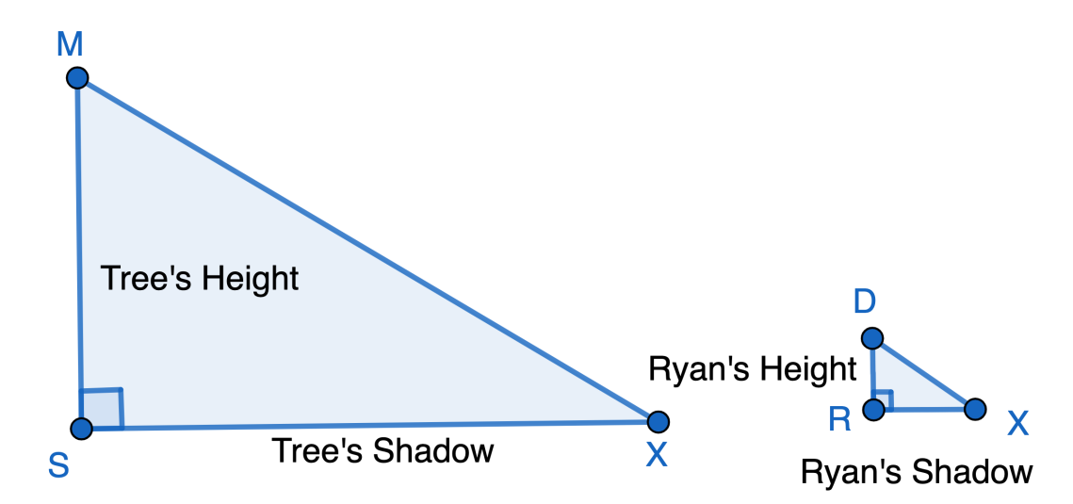
The diagram shows two similar triangles that can be used to represent the situation.
Mark the corresponding angles and label the sides with the known measurements.
volume 1, pg. 270

Slide 19
Determine the constant of proportionality, relating the length of the tree’s shadow to the length of Ryan’s shadow.
Use the constant of proportionality to determine the height of the tree.
volume 1, pg. 270

Slide 20
Explain whether or not the height of the tree in the park is close in height to the bald cypress in Hamilton County.
volume 1, pg. 271

Slide 21

Collaboration
volume 1, pg. 271

Slide 22

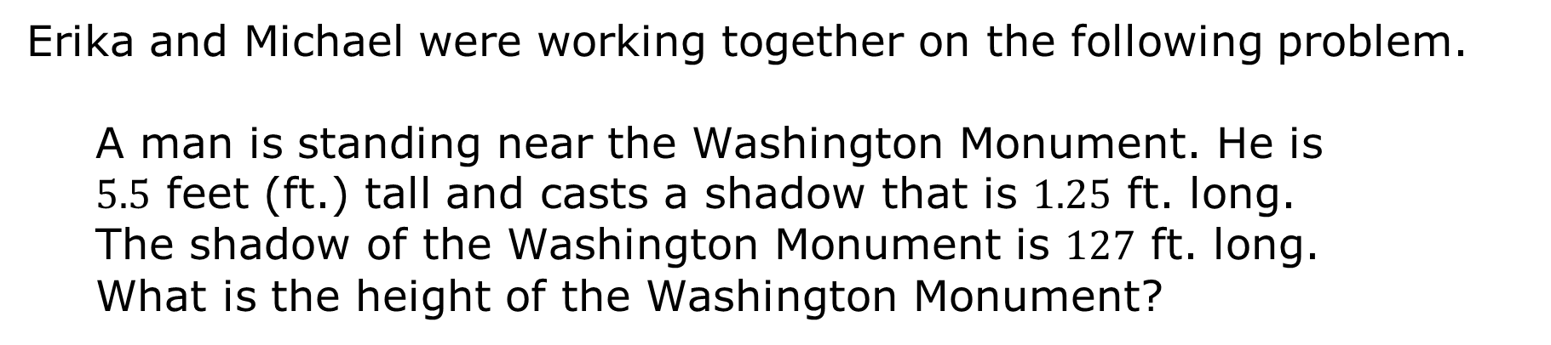
6.6.4 Collaboration: Error Analysis
Erika and Michael were working together on the following problem.
A man is standing near the Washington Monument. He is $5.5$ feet (ft.) tall and casts a shadow that is $1.25$ ft. long. The shadow of the Washington Monument is $127$ ft. long. What is the height of the Washington Monument?
volume 1, pg. 271

Slide 23
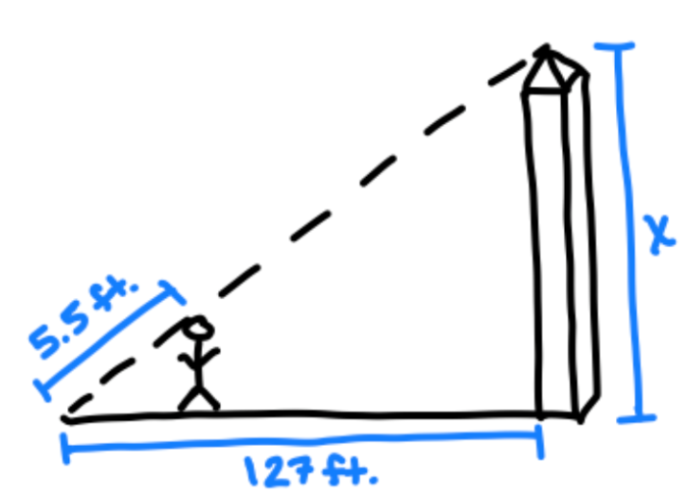
They drew the following visual representation to help solve the problem.
There is an error in their diagram. Describe the mistake they made.
volume 1, pg. 271

Slide 24
Draw a correct diagram. Mark the corresponding angles and label the sides with the known measurements.
Find the height of the Washington Monument.
volume 1, pg. 272

Slide 25
Collaboration
volume 1, pg. 272

Slide 26
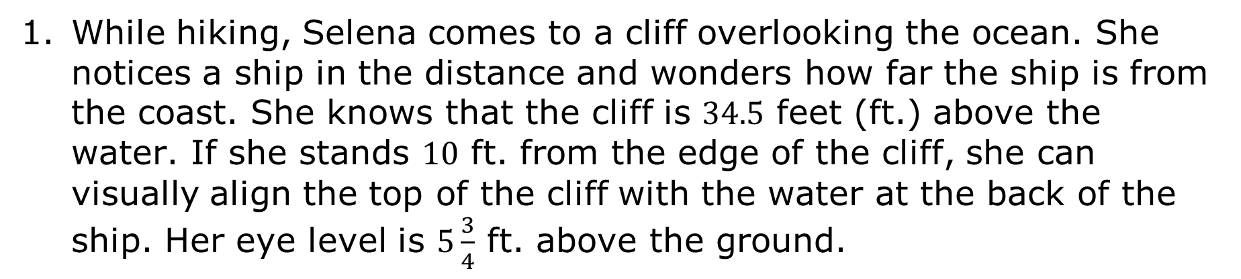
6.6.5 Collaboration: Using Similar Triangles to Solve Real-World Problems
While hiking, Selena comes to a cliff overlooking the ocean. She notices a ship in the distance and wonders how far the ship is from the coast. She knows that the cliff is $34.5$ feet (ft.) above the water. If she stands $10$ ft. from the edge of the cliff, she can visually align the top of the cliff with the water at the back of the ship. Her eye level is $5\frac{3}{4}$ ft. above the ground.
volume 1, pg. 272

Slide 27
Label the similar triangles with the given information.
Find the distance from the coast to the ship.
volume 1, pg. 272

Slide 28
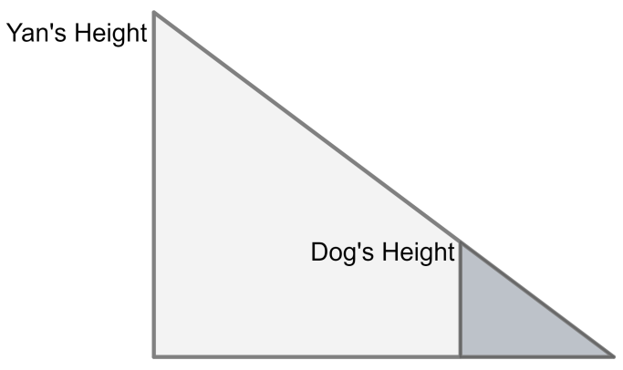

Yan is walking his dog. At a certain point in their walk, he notices that their shadows end at the same spot. Yan’s dog is walking $24$ inches (in.) in front of him. His dog’s height is $27$ in. and is casting a shadow $18$ in. long.
Label the similar triangles with the given information.
Find Yan’s height.
volume 1, pg. 273

Slide 29

Your Turn
volume 1, pg. 273

Slide 30

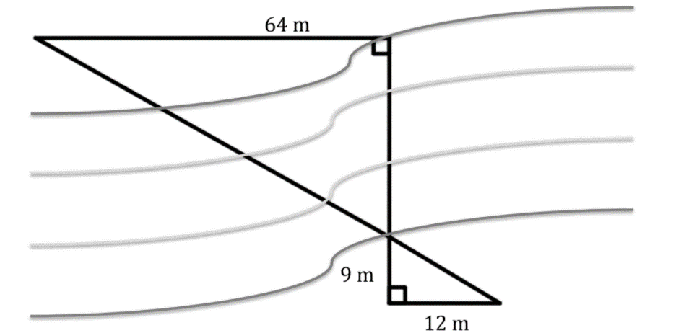
6.6.6 Your Turn!
A surveyor is measuring the width of a river for a future bridge. He is unable to measure across water, so he uses similar triangles and takes a series of measurements on land. The diagram shows his measurements. Use the surveyor’s measurements to determine the width of the river.
volume 1, pg. 273

Slide 31

Wrap-Up
volume 1, pg. 274

Slide 32
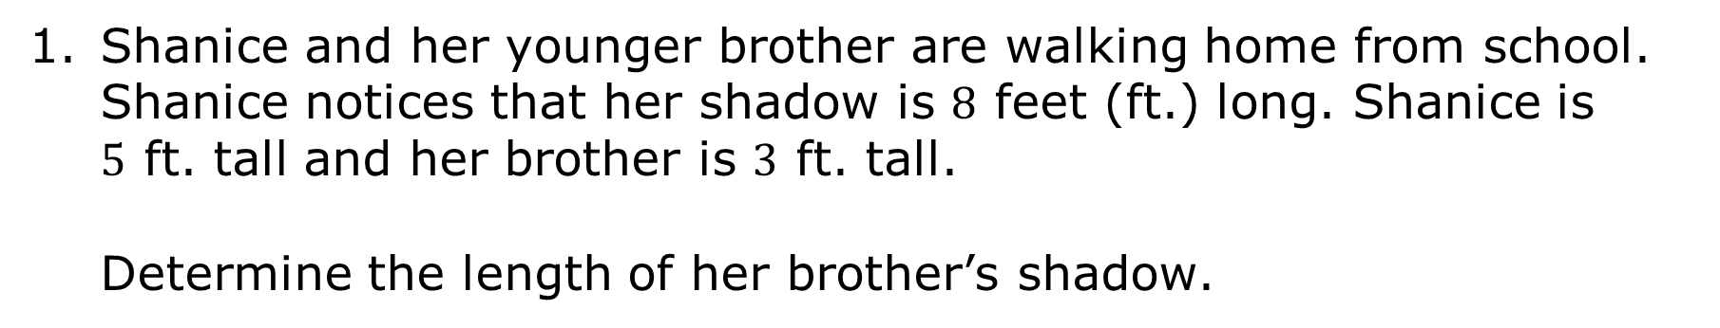
6.6.7 Wrap-Up: Ticket Out the Door
Shanice and her younger brother are walking home from school. Shanice notices that her shadow is $8$ feet (ft.) long. Shanice is $5$ ft. tall and her brother is $3$ ft. tall.
Determine the length of her brother’s shadow.
volume 1, pg. 274

